Slide 1
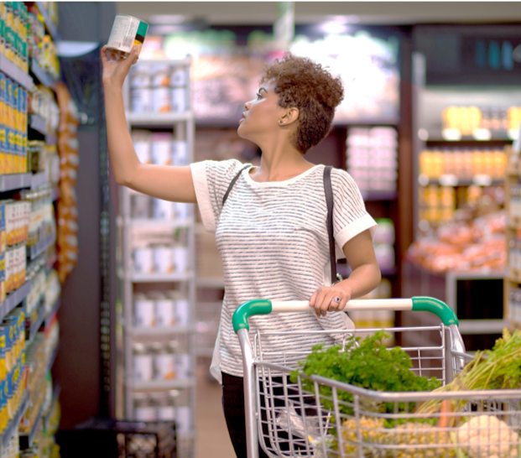

Category review: Chips
RETAIL ANALYTICS
Gifty Cheruvallimalayil
​​

Slide 2


Slide 3
AGENDA
EXECUTIVE SUMMARY
TASK 1: CATEGORY
TASK 2: TRIAL STORE PERFORMANCE
25/05/2022
RETAIL ANALYTICS

Slide 4
Executive Summary
01
Task 1
Sales have mainly been due to Budget - older families, Mainstream young singles/couples, and Mainstream - retirees shoppers. We can help the Category Manager with recommendations of where these segments are and further help them with measuring the impact of the changed placement.
02
Task 2
We've found control stores 233, 155, 178 for trial stores 77, 86 and 88 respectively. The results for trial stores 77 and 86 during the trial period show a significant difference in at least two of the three trial months but this is not the case for trial store 88.

Slide 5
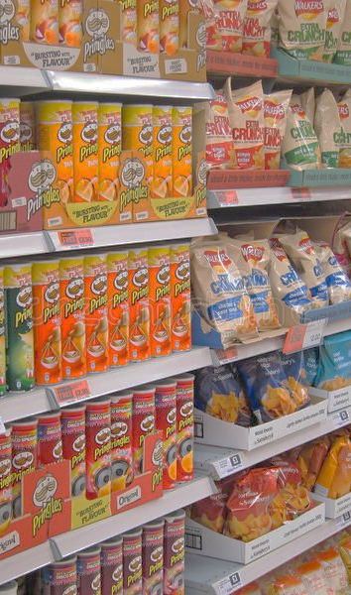
TASK 1: CATEGORY
Overview
Sales have mainly been due to Budget - older families, Mainstream young singles/couples, and Mainstream - retirees shoppers. We found that the high spend in chips for mainstream young singles/couples and retirees is due to there being more of them than other buyers. Mainstream, midage and young singles and couples are also more likely to pay more per packet of chips. This is indicative of impulse buying behavior.
We’ve also found that Mainstream young singles and couples are 23% more likely to purchase Tyrrells chips compared to the rest of the population. The Category Manager may want to increase the category’s performance by off-locating some Tyrrells and smaller packs of chips in discretionary space near segments where young singles and couples frequent more often to increase visibility and impulse behavior.
Quantium can help the Category Manager with recommendations of where these segments are and further help them with measuring the impact of the changed placement.

Slide 6
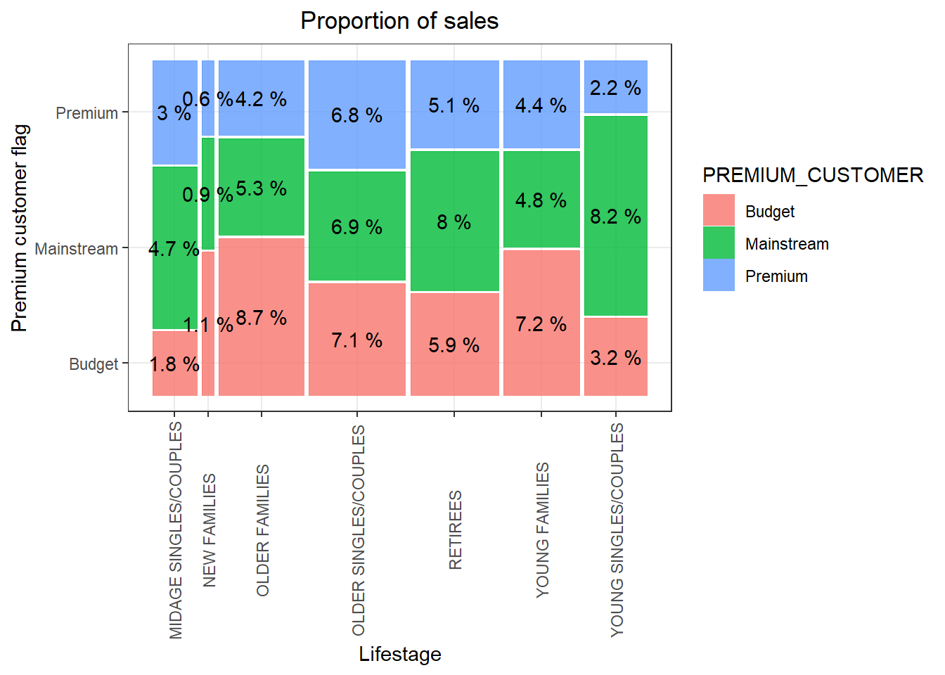
affluence and its effect on consumer buying for the category of chips
Sales are coming mainly from
Budget - older families,
Mainstream-young singles/couples
Mainstream - retirees

Slide 7
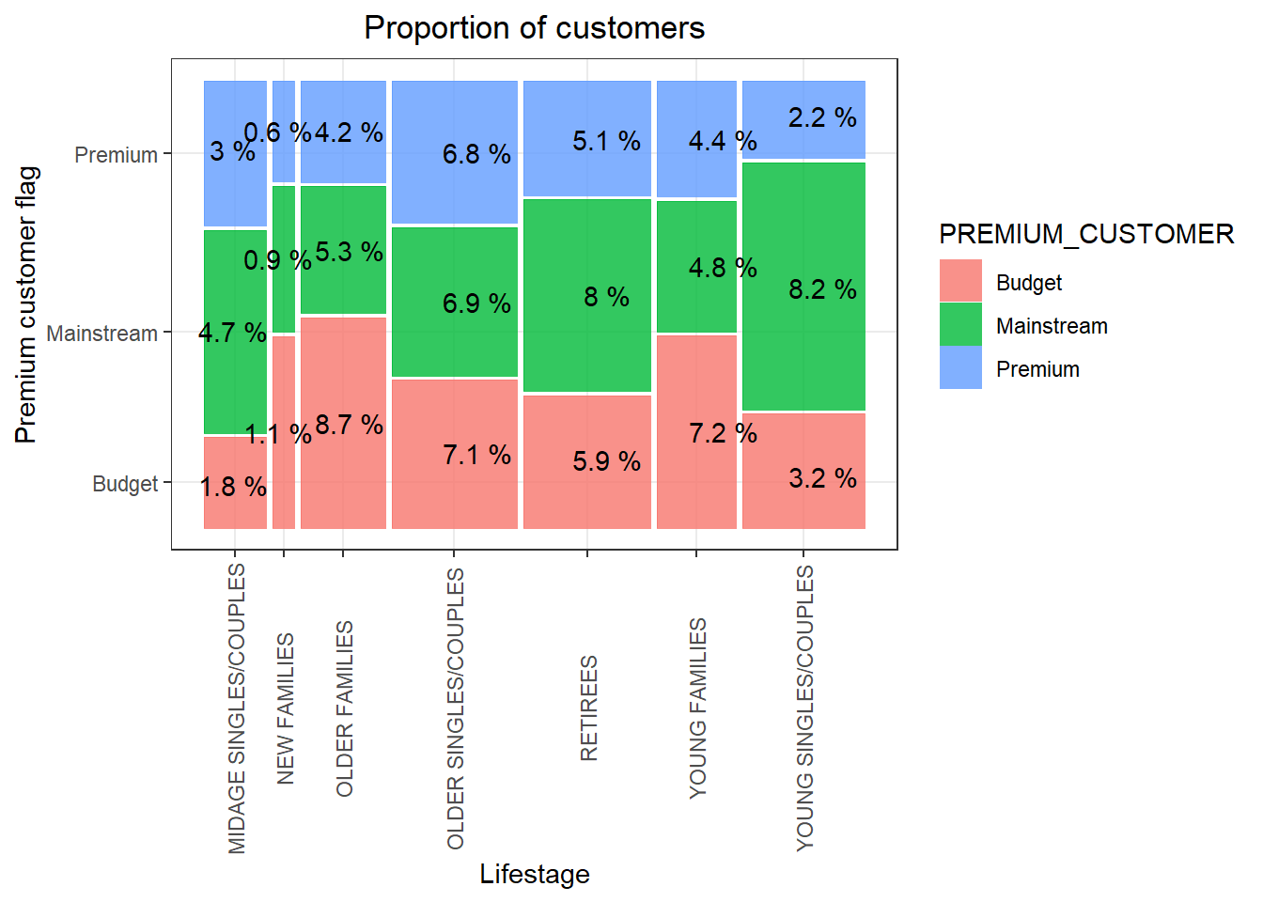
the proportion of customers by affluence and life stage on this slide
There are more Mainstream - young singles/couples and Mainstream - retirees who buy chips.
This contributes to there being more sales to these customer segments but this is not a major driver for the Budget - Older families segment.

Slide 8
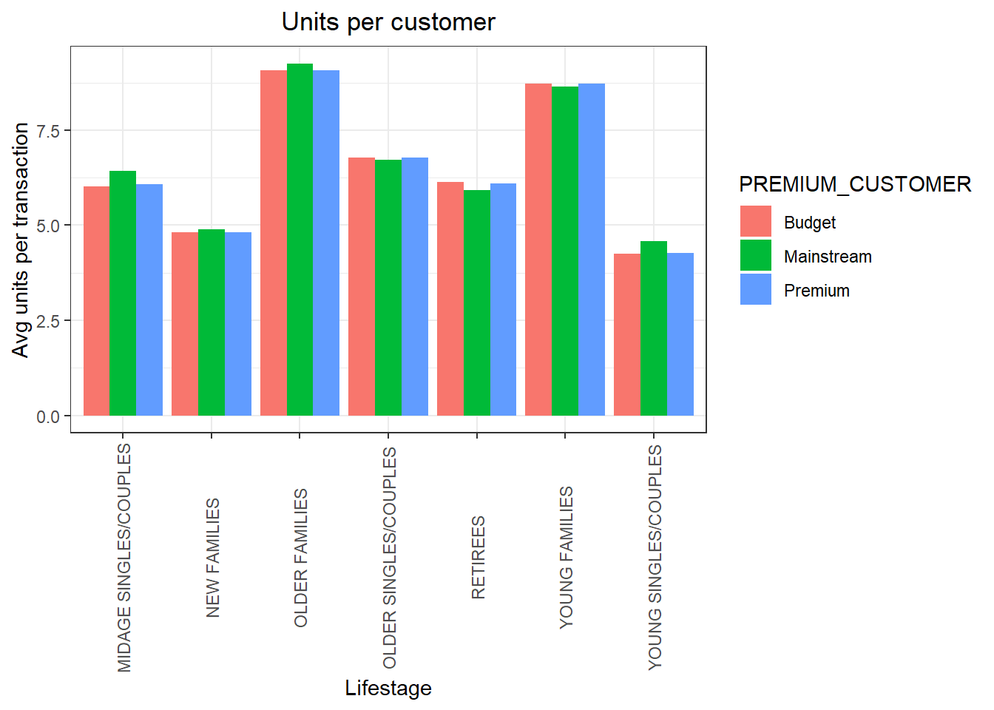
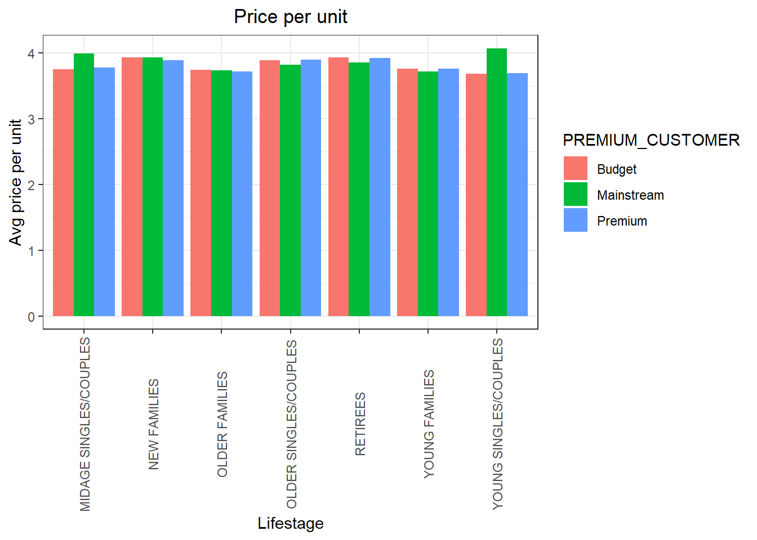
Average number of units And price per customer by LIFESTAGE and PREMIUM_CUSTOMER
Older families and young families in general buy more chips per customer
The difference in average price per unit isn’t large

Slide 9
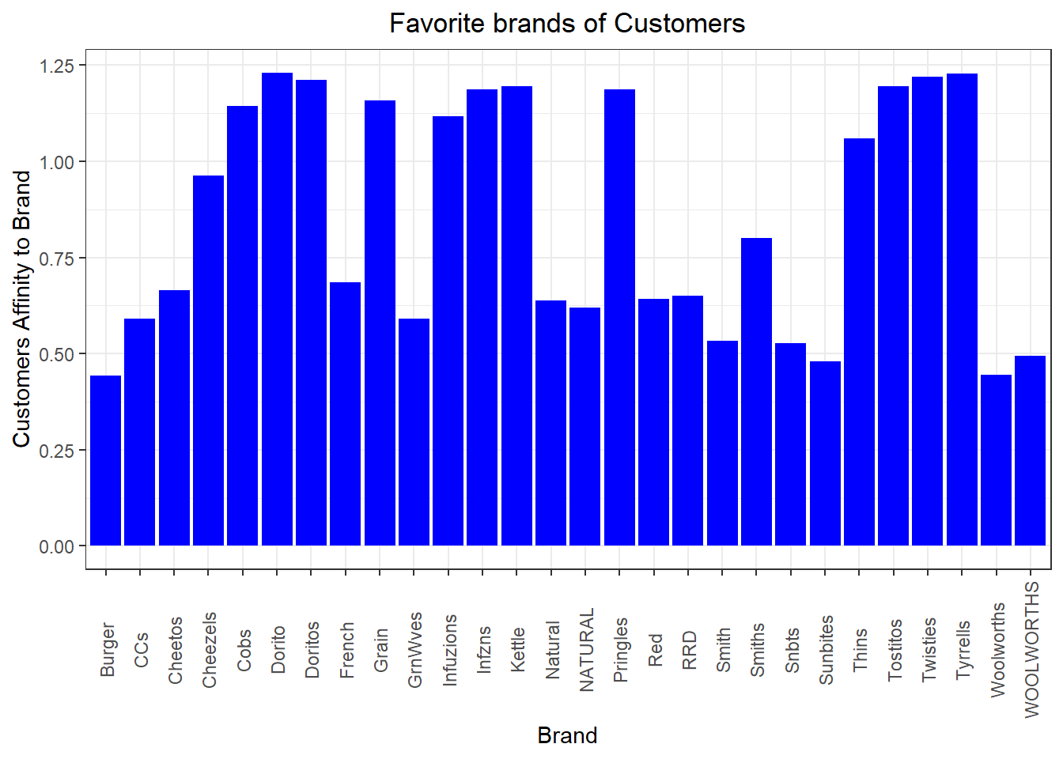
Brand affinity compared to the rest of the population
Here, We can see that:
Mainstream young singles/couples are 56% less likely to purchase Burger Rings compared to the rest of the population
Mainstream young singles/couples are 23% more likely to purchase Tyrrells chips compared to the rest of the population

Slide 10
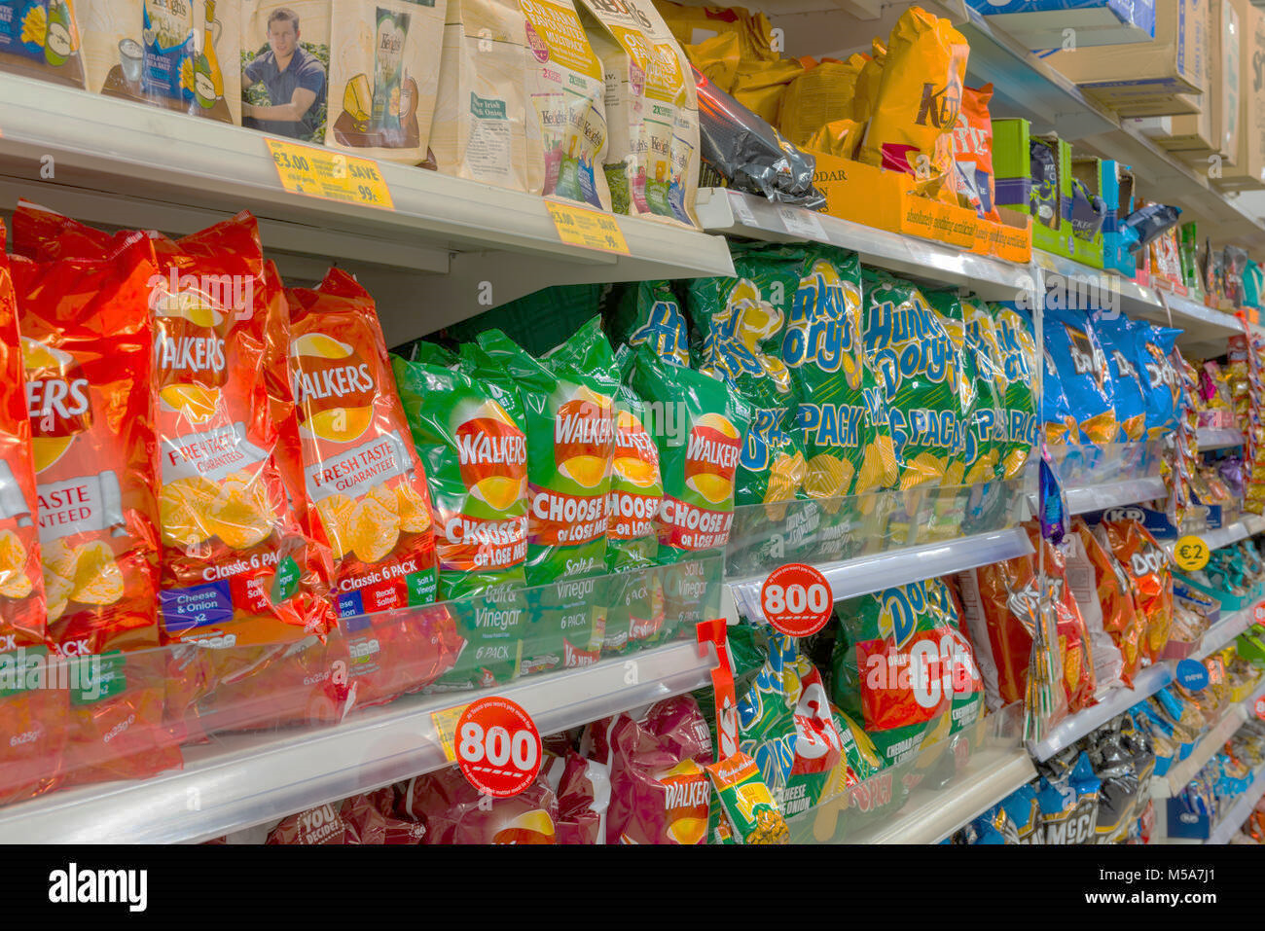
TASK 2: TRIAL STORE PERFORMANCE
Control Store vs trial store
We’ve found control stores 233, 155, 237 for trial stores 77, 86 and 88 respectively.
The results for trial stores 77 and 88 during the trial period show a significant difference in at least two of the three trial months but this is not the case for trial store 86. We can check with the client if the implementation of the trial was different in trial store 86 but overall, the trial shows a significant increase in sales.

Slide 11
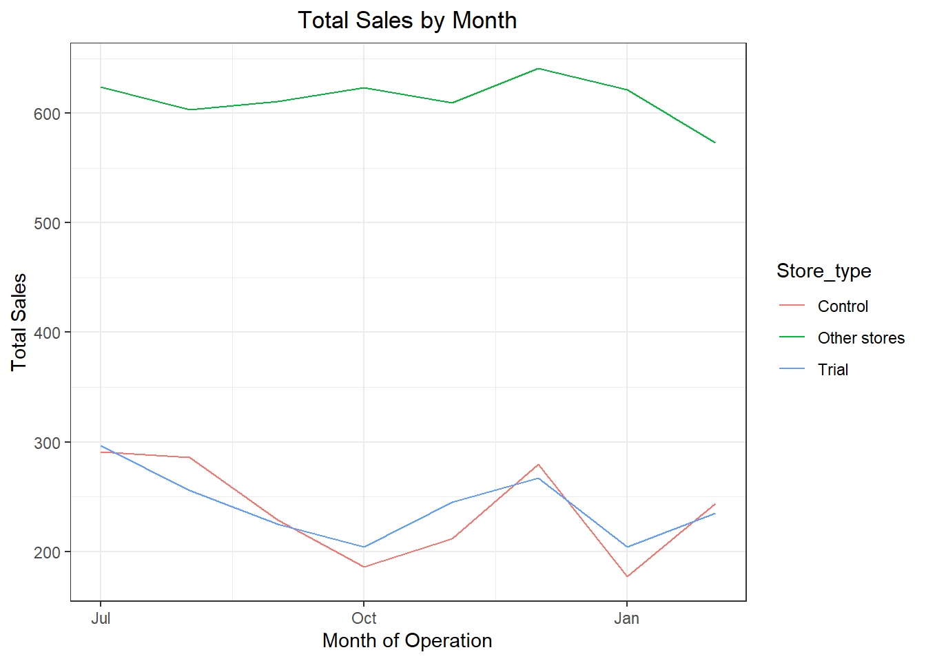
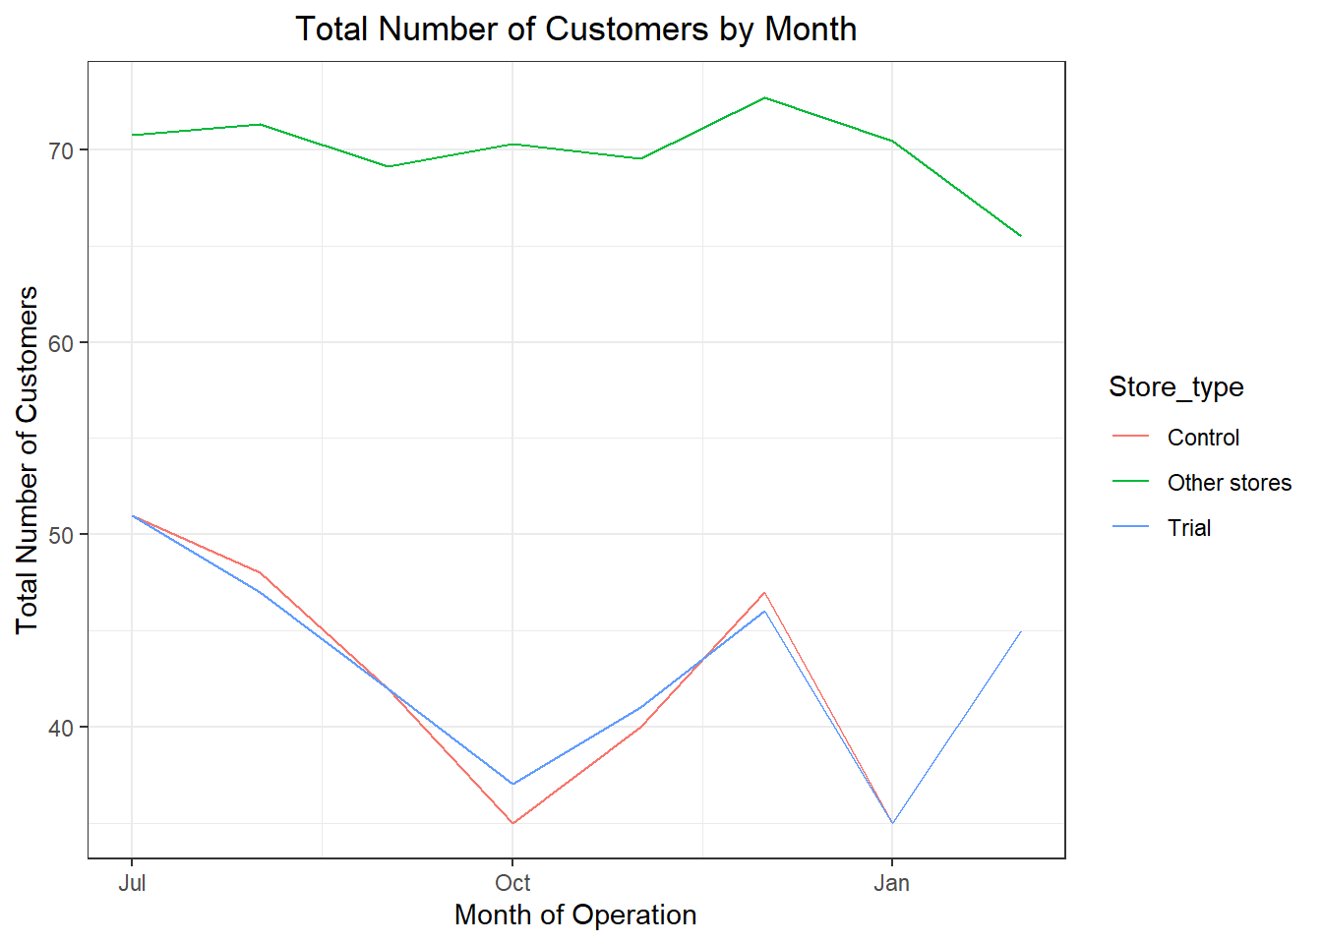
trial store 77

Slide 12
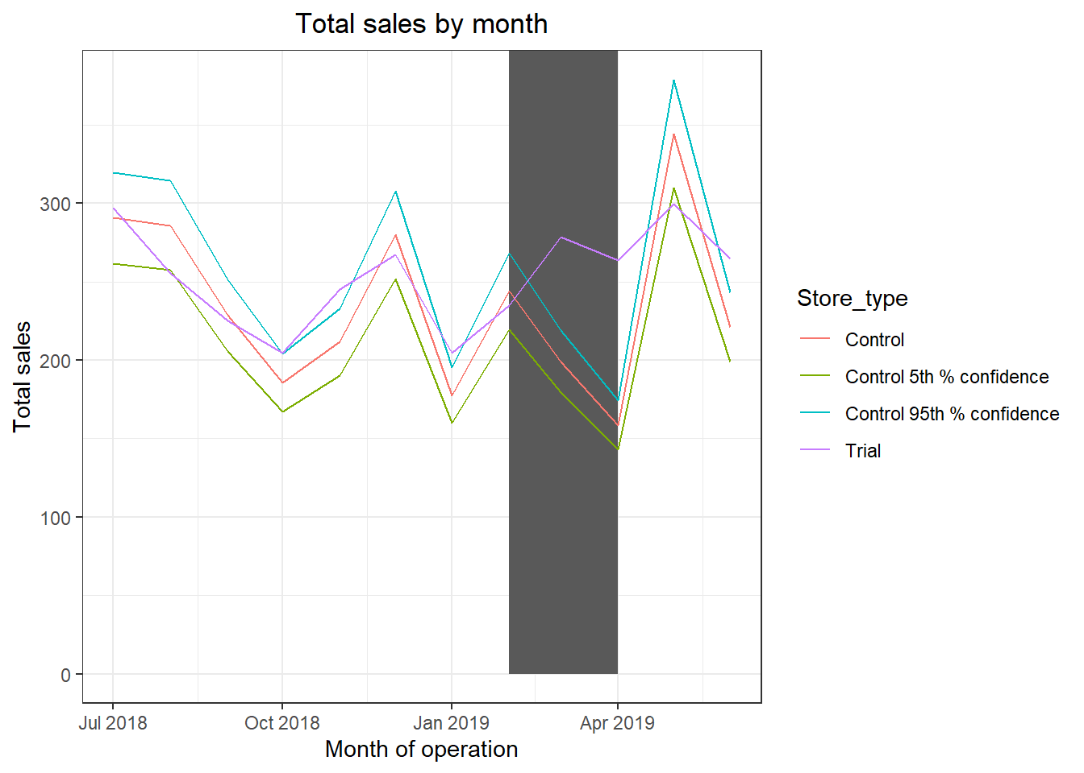
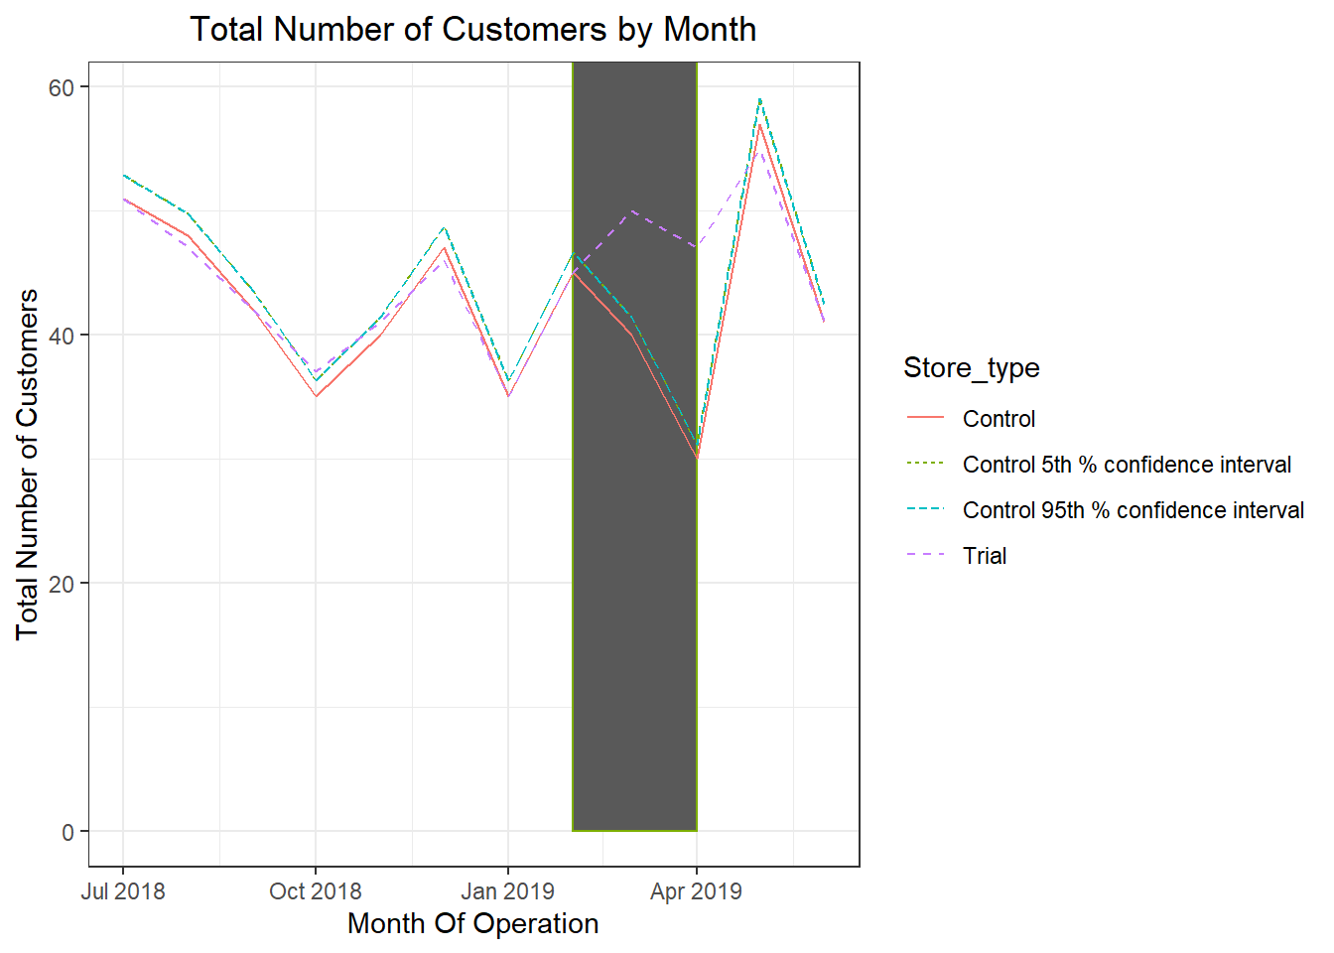
trial store 77

Slide 13
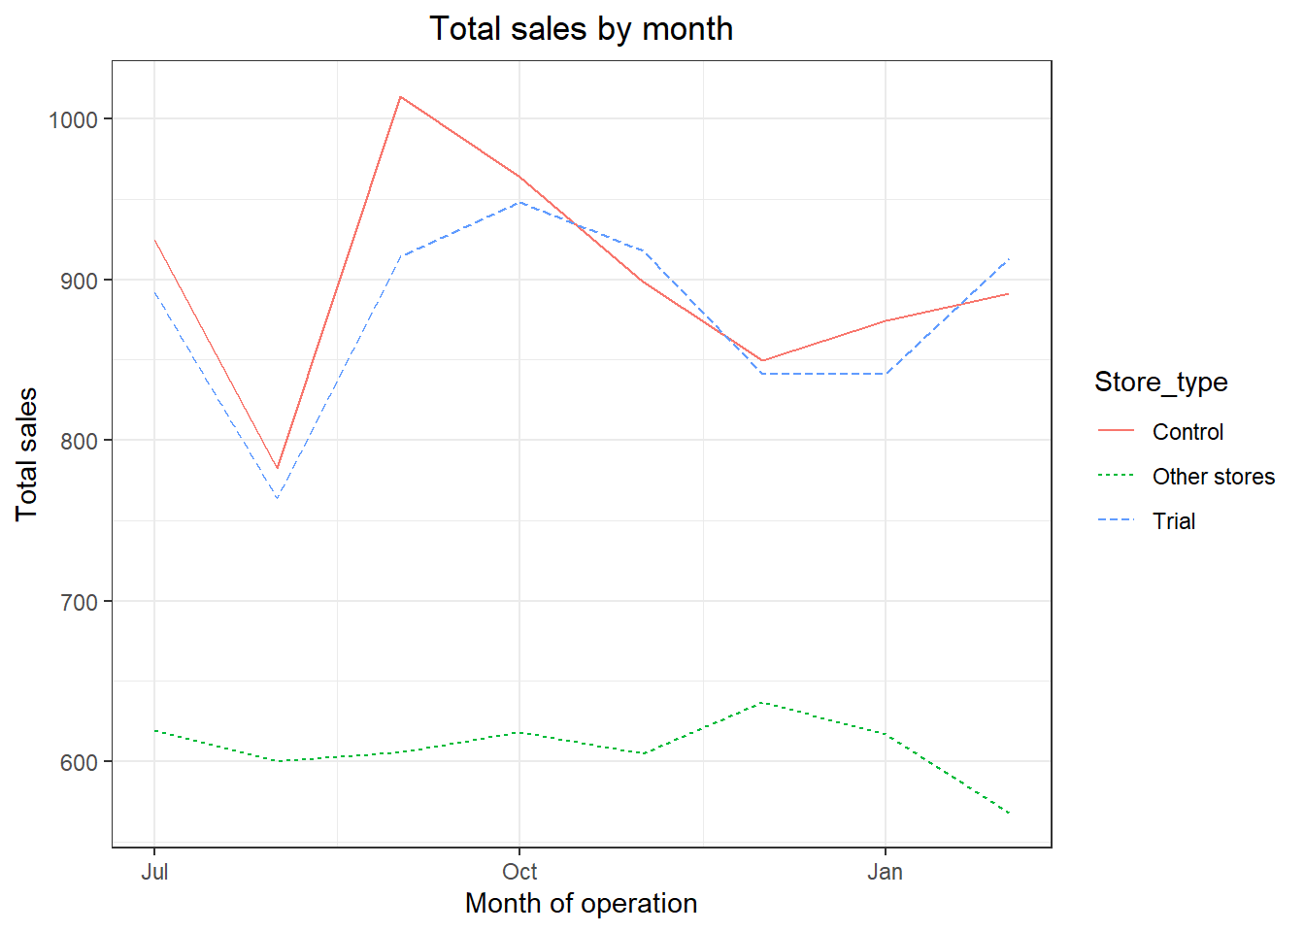
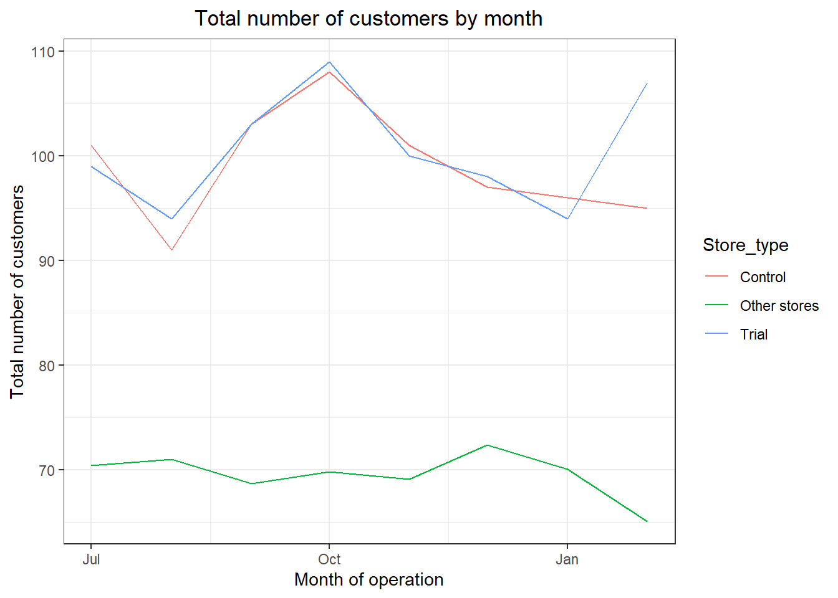
trial store 86

Slide 14
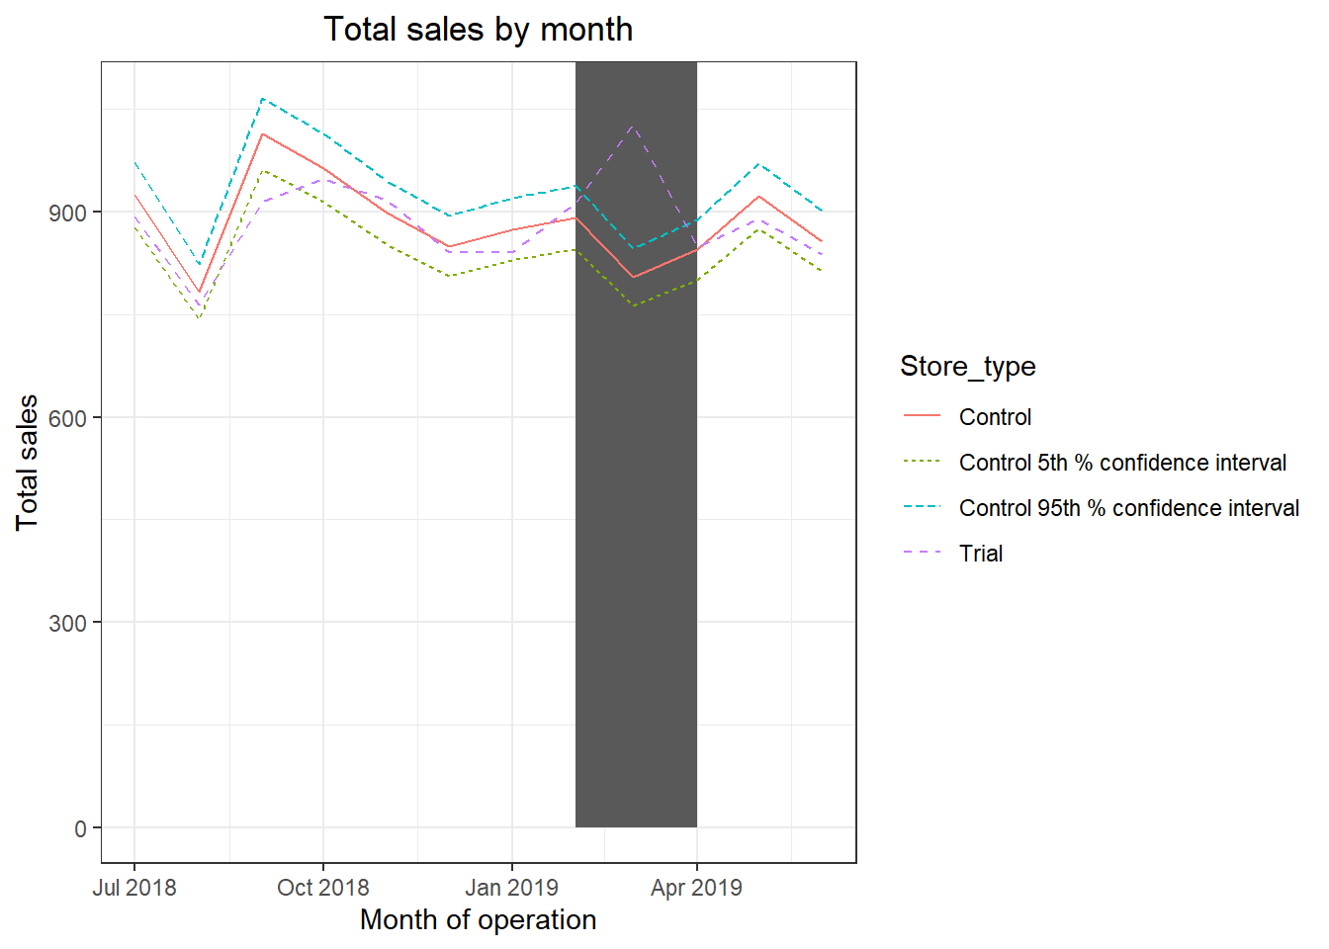
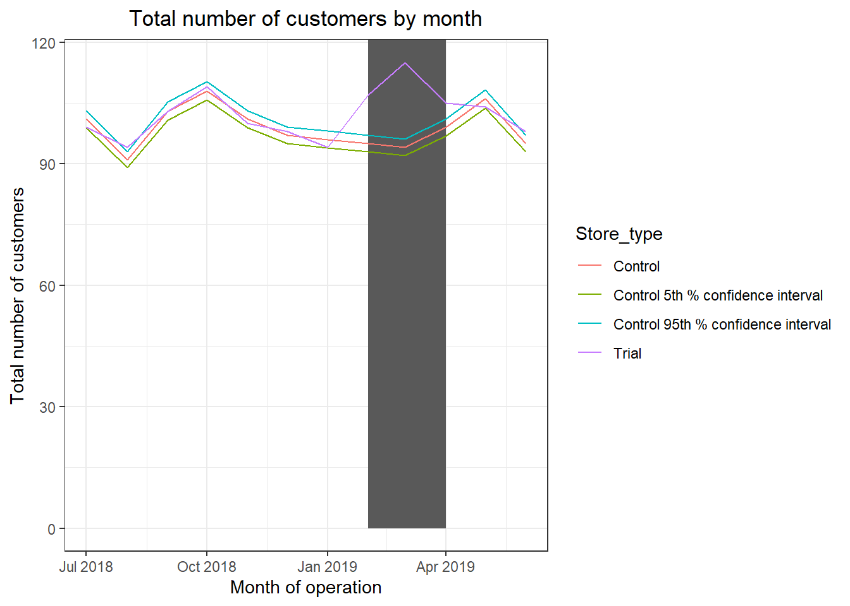
trial store 86

Slide 15
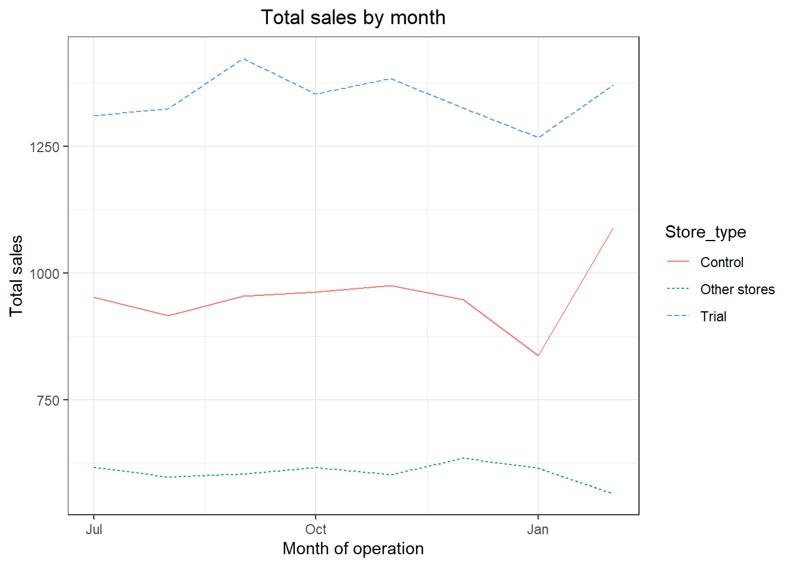
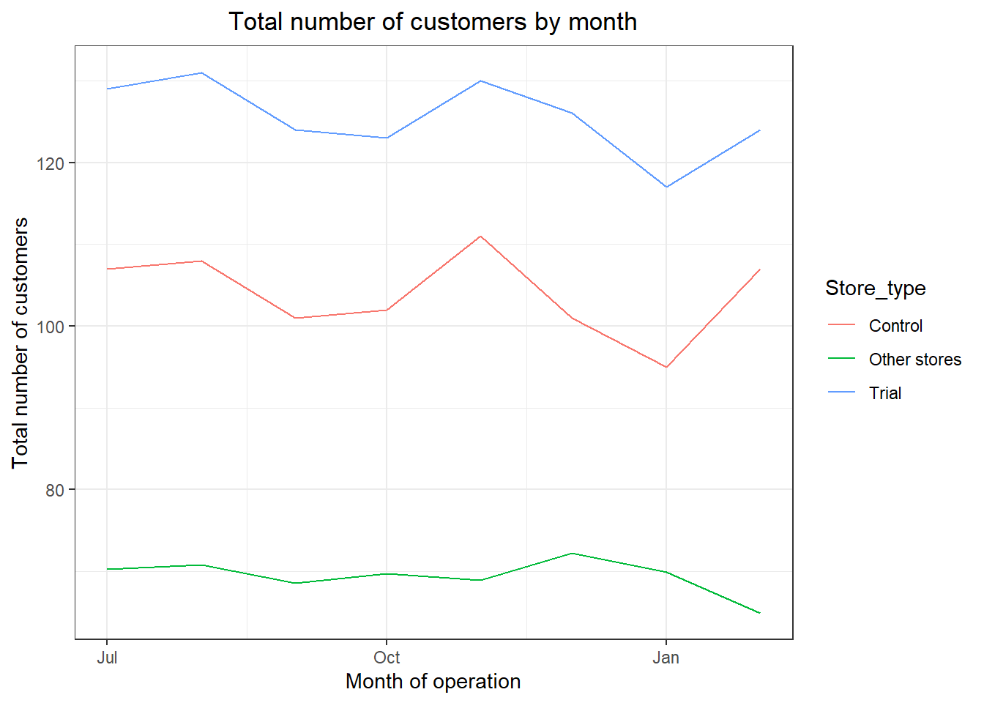
trial store 88

Slide 16
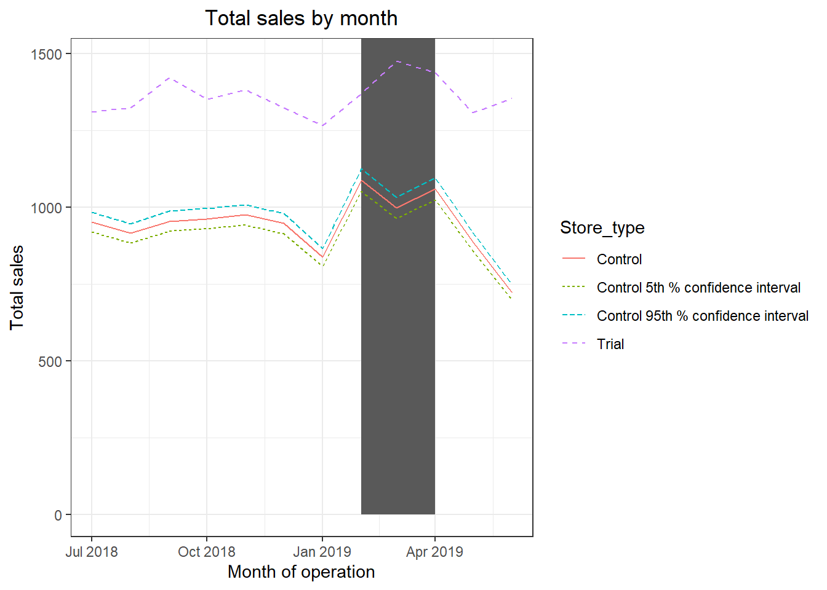
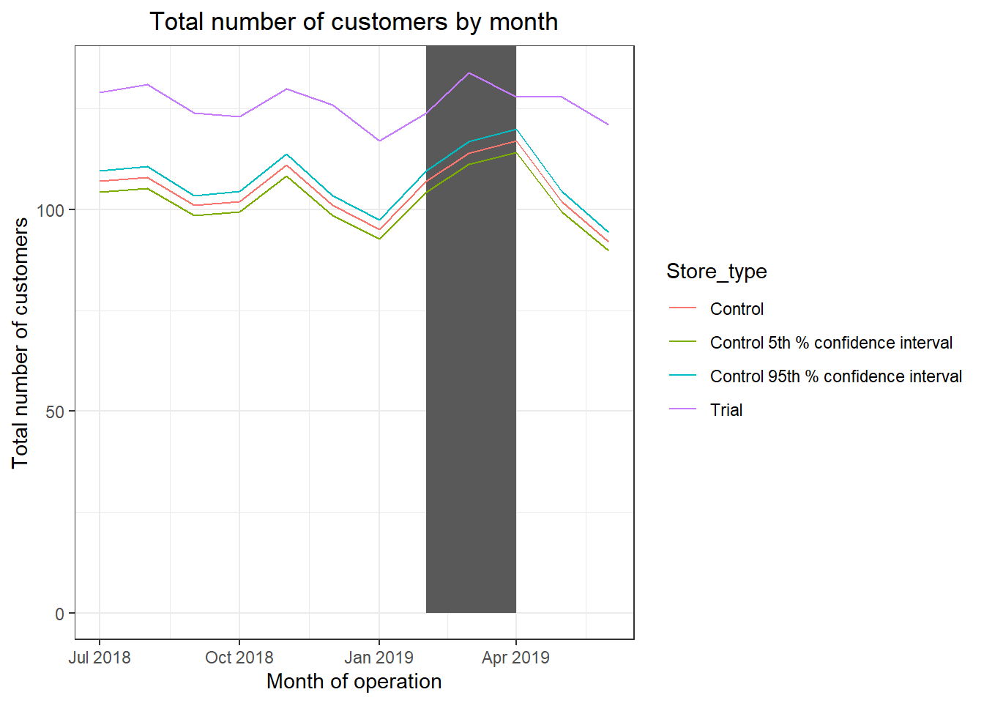
trial store 88

Slide 17

Thank You
Gifty Cheruvallimalayil

